Slide 1
Research Presentation 9-18-25
By: Helder Rebelo

Slide 2
From Last Week
Investigated different loading method for mode I and mode II simulations.
Updated simulation to match mode I loading criteria.
Created output file with values I believed would be necessary for future of the simulation.

Slide 3
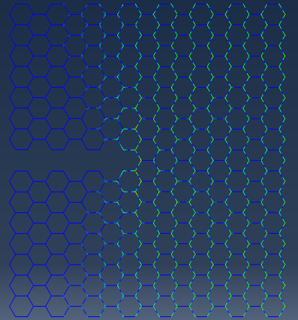
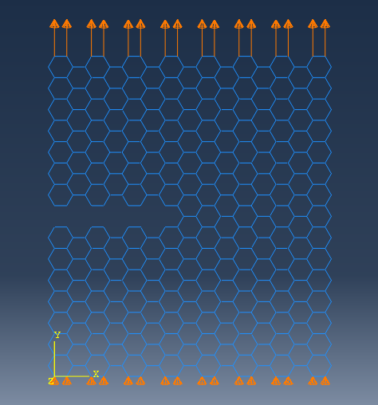
Simulation

Slide 4
Data
# W=4.600000e+02 | H=5.196152e+02 | B=1.000000e-02 | a=2.200000e+02 | ell=2.000000e+01 | rect_b=1.000000e-01
# YI=1.000000e+00 | parent_sigma_f=1.000000e+02 | bar_rho=5.823707e-03 | k0=-3.336554e-06 | E_eff_init=-3.768966e-04
# u_f=1.000000e-02 | P_f=-3.345485e-08 | eps_f=1.924501e-05 | sig_f=-7.272794e-09 | W_f=-1.672742e-10 | K_Ic=-1.911998e-07 | barK_Ic=-4.275358e-10
time | u | P | eps | sig | du | dP | k_tangent | W_cum | is_failure
0.000000e+00 | 0.000000e+00 | 0.00E+00 | 0.000000e+00 | 0.00E+00 | 0.000000e+00 | 0.000000e+00 | -3.35E-06 | 0.000000e+00 | 0
1.000000e-01 | 1.000000e-02 | -3.35E-08 | 1.924501e-05 | -7.27E-09 | 1.000000e-02 | -3.35E-08 | -3.33E-06 | -1.67E-10 | 1
2.000000e-01 | 2.000000e-02 | -6.67E-08 | 3.849002e-05 | -1.45E-08 | 1.000000e-02 | -3.32E-08 | -3.33E-06 | -6.68E-10 | 0
3.500000e-01 | 3.500000e-02 | -1.17E-07 | 6.735753e-05 | -2.54E-08 | 1.500000e-02 | -5.00E-08 | -3.34E-06 | -2.04E-09 | 0
5.750000e-01 | 5.750000e-02 | -1.92E-07 | 1.106588e-04 | -4.17E-08 | 2.250000e-02 | -7.51E-08 | -3.34E-06 | -5.51E-09 | 0
9.125000e-01 | 9.125000e-02 | -3.04E-07 | 1.756107e-04 | -6.62E-08 | 3.375000e-02 | -1.13E-07 | -3.34E-06 | -1.39E-08 | 0
1.418750e+00 | 1.418750e-01 | -4.74E-07 | 2.730386e-04 | -1.03E-07 | 5.062500e-02 | -1.69E-07 | -3.34E-06 | -3.36E-08 | 0
2.178125e+00 | 2.178125e-01 | -7.28E-07 | 4.191803e-04 | -1.58E-07 | 7.593749e-02 | -2.54E-07 | -3.35E-06 | -7.92E-08 | 0
3.178125e+00 | 3.178125e-01 | -1.06E-06 | 6.116304e-04 | -2.31E-07 | 1.000000e-01 | -3.35E-07 | -3.36E-06 | -1.69E-07 | 0
4.178125e+00 | 4.178125e-01 | -1.40E-06 | 8.040805e-04 | -3.04E-07 | 9.999999e-02 | -3.36E-07 | -3.36E-06 | -2.92E-07 | 0
5.178125e+00 | 5.178125e-01 | -1.74E-06 | 9.965306e-04 | -3.77E-07 | 9.999999e-02 | -3.37E-07 | -3.37E-06 | -4.49E-07 | 0
6.178125e+00 | 6.178125e-01 | -2.07E-06 | 1.188981e-03 | -4.51E-07 | 1.000000e-01 | -3.37E-07 | -3.38E-06 | -6.39E-07 | 0
7.178125e+00 | 7.178125e-01 | -2.41E-06 | 1.381431e-03 | -5.24E-07 | 9.999996e-02 | -3.38E-07 | -3.38E-06 | -8.63E-07 | 0
8.178125e+00 | 8.178125e-01 | -2.75E-06 | 1.573881e-03 | -5.98E-07 | 1.000000e-01 | -3.39E-07 | -3.39E-06 | -1.12E-06 | 0
9.178125e+00 | 9.178125e-01 | -3.09E-06 | 1.766331e-03 | -6.72E-07 | 1.000000e-01 | -3.39E-07 | -3.40E-06 | -1.41E-06 | 0
1.000000e+01 | 1.000000e+00 | -3.37E-06 | 1.924501e-03 | -7.32E-07 | 8.218747e-02 | -2.80E-07 | -3.40E-06 | -1.68E-06 | 0

Slide 5
Data (Continued)
W | H | B | a | ell | rect_b | bar_rho | k0 | E_eff_init | u_f | P_f | eps_f | sig_f | W_f | YI | parent_sigma_f | K_Ic | barK_Ic
4.60E+02 | 5.20E+02 | 1.00E-02 | 2.20E+02 | 2.00E+01 | 1.00E-01 | 5.82E-03 | -3.34E-06 | -3.77E-04 | 1.00E-02 | -3.35E-08 | 1.92E-05 | -7.27E-09 | -1.67E-10 | 1.00E+00 | 1.00E+02 | -1.91E-07 | -4.28E-10
W: specimen width (x-span)
H: specimen height (y-span)
B: out-of-plane thickness (rect_a)
a: crack half-length (tip→edge)
ell: lattice cell size
rect_b: strut in-plane thickness
bar_rho: 2-D relative density (area fraction)
k0: initial global stiffness (dP/du)
E_eff_init: initial effective modulus (dσ/dε)
u_f: displacement at failure
P_f: load at failure
eps_f: nominal strain at failure (u_f/H)
sig_f: nominal stress at failure (P_f/(B·W))
W_f: work to failure (∫P du)
YI: shape factor for K (geometry)
parent_sigma_f: parent solid tensile strength
K_Ic: fracture toughness (YI·sig_f·√(πa))
barK_Ic: normalized toughness (K_Ic/(parent_sigma_f·√ell))

Slide 6
Data Analysis

Slide 7
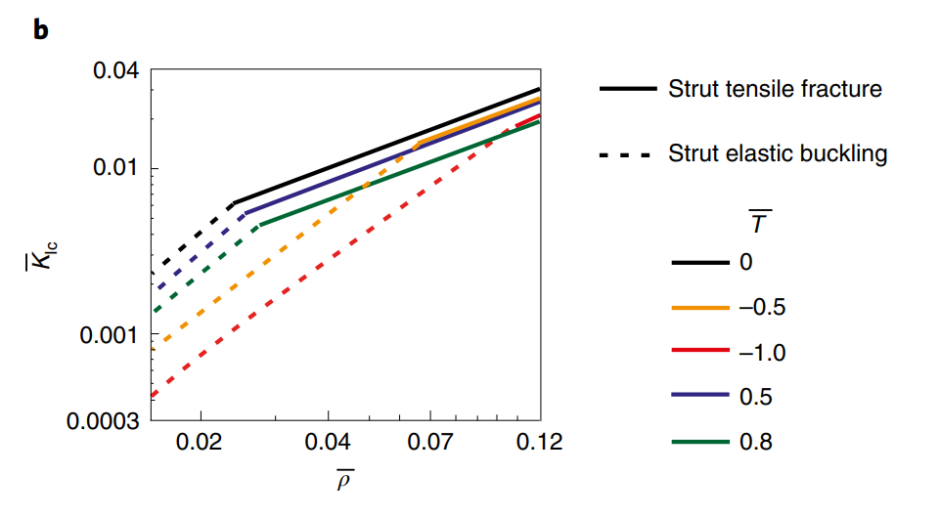
Questions
Is this model large enough?
Should I increase my displacement (U2=1mm)?
Should I sweep rect_b values in the code and plot Kic vs relative density to recreate this figure.

